Slide 1
Session 7

Slide 2
CO2-Data Visualization
Data Analytics Communication
Data Types for Plotting
Data Types
Plotting
Simple Line Plots

Slide 3
Data Analysis
It is the most crucial steps that deals with descriptive statistics and analysis of the data.
Summarizing the data, finding the hidden correlation and relationships among the data.
Developing predictive models, evaluating the models, and calculating the accuracies.

Slide 4
Data Analysis Techniques
Data summarization are summary tables,
Graphs
Descriptive statistics, inferential statistics, correlation statistics.
Searching, grouping, and mathematical models

Slide 5
What is Data?
Data is the collected information(observations).
It is about something or facts and statistics collected together for reference or analysis.
A collection of facts (numbers, words, measurements, observations, etc)
Translated into a form that computers can process

Slide 6
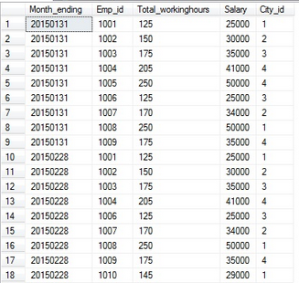
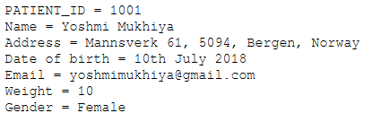
Data Pattern

Slide 7
Why does Data Matter?
Understanding more about the data by identifying relationships that may exist between 2 variables.
Predicting the future or forecast based on the previous trend of data.
Determining patterns that may exist between data.
Detecting fraud by uncovering anomalies in the data.

Slide 8
Data Types for Plotting
Data
Quantitative
Discrete
Continuous
Qualitative
Categorical
Binary
Ordinal

Slide 9
Quantitative Data
The information is recorded as numbers.
Represents an objective measurement or a count.
It can be counted or expressed numerically.
Temperature, weight, and a count of transactions are all quantitative data.
With quantitative data, we are usually trying to answer questions involving quantity, frequency, value, or size.

Slide 10
Continuous Data
Continuous variables can take on any numeric value.
It can be meaningfully divided into smaller increments, including fractional and decimal values.
There are an infinite number of possible values between any two values. Typically, you measure continuous variables on a scale.
For example, when you measure height, weight, and temperature, you have continuous data.

Slide 11
Discrete Data
Discrete data has a limited number of possible values (e.g., whole numbers from 1-100).

Slide 12
Qualitative
The information represents characteristics that you do not measure with numbers.
Instead, the observations fall within a countable number of groups.
This type of variable can capture information that isn’t easily measured and can be subjective.
Example: Taste, eye color, architectural style, and marital status

Slide 13
Categorical Data
A countable number of distinct groups based on a characteristic.
For a categorical variable, assign categories, but the categories have no natural order.
For example, college major is a categorical variable that can have values such as psychology, political science, engineering, biology, etc.

Slide 14
Binary Data
Binary data can have only two values. If you can place an observation into only two categories, you have a binary variable.
For example, pass/fail, male/female, and the presence/absence of a characteristic are all binary data.

Slide 15
Ordinal Data
It has three categories, and the categories have a natural order.
Examples of ordinal variables include overall status (poor to excellent), agreement (strongly disagree to strongly agree), and rank (such as sporting teams).

Slide 16
Introduction to Data Visualization
Data Visualization is basically putting the analyzed data in the form of visuals like - graphs, images.
It easy for humans to understand the analyzed trends through visuals.
It will make it easier for them to understand through graphs and charts.

Slide 17
Why need Data Visualization?
Interpreting data better and memorable.
Understand the insight of the data
Noticing correlations
Figuring outliers
Feature Engineering
Cause-Effect relations

Slide 18
Benefits of Data Visualization
Intuitive: Presenting a graph as a node-link structure instantly makes sense, even to people who have never worked with graphs before.
Fast: It is fast because our brains are great at identifying patterns. Armed with visualization, we can spot trends and outliers very effectively.
Flexible: Interesting relationship in your data somewhere, we can find the value in graph visualization.

Slide 19
Where we need Data Visualization
Retail Stock Market
Weather forecast
Disease prediction and detection etc.

Slide 20
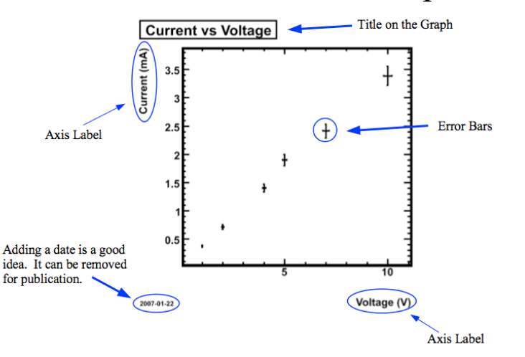
Plotting

Slide 21
Type of Plots
There are many types of visualizations.
line plot
scatter plot
histogram
box plot
bar chart
pie chart.

Slide 22
How do we choose the right Visualization?
Need to make some exploratory data analysis.
Need to understand the shape of the data
The data types.
Useful statistical information, it will be easier to pick the right visualization type.

Slide 23
Important Components for Potting
Python 3.X You must have
Python libraries
Pandas
NumPy
SciPy
Matplotlib

Slide 24
Simple Line Plots
It can display information as a series of data points and connected by straight lines.
Data points are called “Marker”
In this type of plot, we need the measurement points to be ordered (typically by their x-axis values).
This type of plot is often used to visualize a trend in data over intervals of time - a time series.

Slide 25
Why Simple Line Plots
Understand trends, patterns, and fluctuations in the data
Compare different related data sets with multiple series.
Make projections beyond your data.

Slide 26
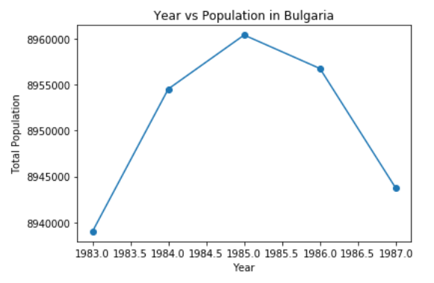
import matplotlib.pyplot as plt
years = [1983, 1984, 1985, 1986, 1987]
total_populations = [8939007, 8954518, 8960387, 8956741, 8943721]
plt.plot(years, total_populations,marker='o')
plt.title("Year vs Population in Bulgaria")
plt.xlabel("Year")
plt.ylabel("Total Population")
plt.show()

